Slide 1
HANDWRITTEN DIGIT RECOGNITION
Submitted to : Peeyush Jain

Slide 2
Problem Statement
The calligraphic skills of every person is different so, the Aim of our project is to implement classification to recognize handwritten digits (0-9) using neural network algorithm and predict number in the image.
Team
Manish Kumar Gupta(20B)
Aditya Sharma(25B)
Sahil Kumar(26B)
Manik Mehta

Slide 3
SCOPE OF DIGIT RECOGNITION
Postal Code Reading
Census Data Collection and Processing
Major Use in Banking Sector
Finance and Marketing
Database

Slide 4
Understanding Dataset
In our dataset, we have image pixels of handwritten digits of 20x20 size. Pixel value is main property of an image. We unroll these 20x20 pixel values in a vector of 400 length. This data is provided by THE MNIST DATABASE of handwritten digits. So in this dataset, we have 5000 images of 400 features and we divide this data into three parts training dataset (60%) ,cross-validation dataset (20%) and testing dataset (20%) and we also have label associated with each image from 1 to 10. Here 10 is used for digit 0.

Slide 5
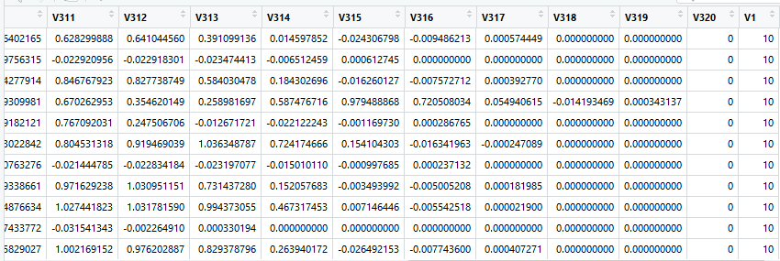
Our dataset

Slide 6
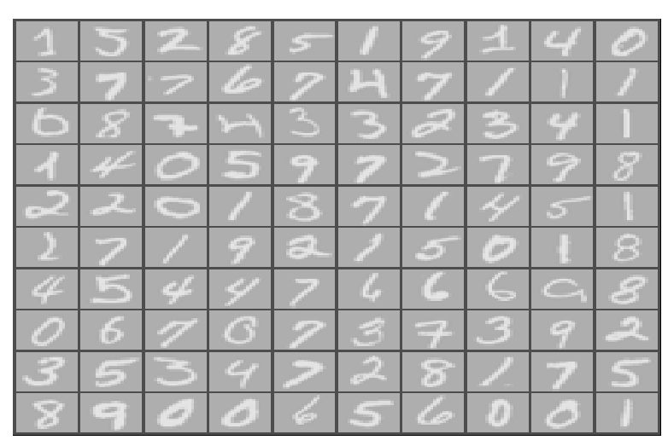
Data Visualization
We display 100 images (20x20) of handwritten digits in a grid of 10x10

Slide 7
Approach to solution
We make a neural network with 1-hidden layer
Input layer will have 400 nodes(features)
Hidden- layer will have 25 nodes
Output layer will have 10 nodes. Each for one digit.
We first feed inputs for forward propagation and find cost error
Then to optimize cost we apply gradient descent
For finding gradients of each parameter, we back-propagate from layer L to 1.
We follow these steps a number of times.

Slide 8
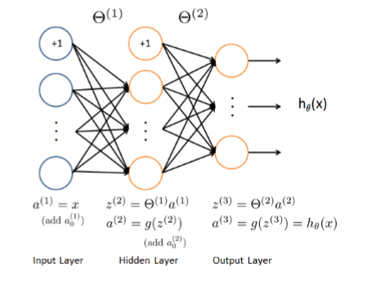
Forward propagation
a^{[1]} = x (add 1’s in X_{o})
Z^{[1]} = θ^{[1]}a^{[1]}
a^{[2]} = g(Z^{[1]}) (add 1’s in a₀^{[2]})
Z^{[2]} = θ^{[2]}a^{[2]}
h_{θ}(x) =a^{[3] =} g(Z^{[2]}) (add 1’s in a₀^{[3]})
So on till L layers

Slide 9
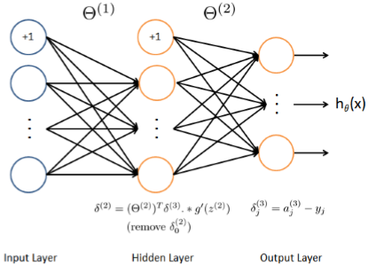
Back propagation
δ_{j}⁽³⁾ = a_{j}⁽³⁾- y_{i}
δ_{j}⁽²⁾ = (θ⁽²⁾)^{T}δ⁽³⁾ * g’(z⁽²⁾)
Remove additionally added δ₀⁽²⁾
Calculate gradient Δ^{(l) =} Δ^{(l)}+δ^{(l+1)}(a^{(l)})^{T}
Partial derivative of cost w.r.t to θ
∂J(θ)/∂θ_{ij}^{(l)} = Δ_{ij}^{(l)}/m
Then calculate
θ_{ij}^{(l)} = θ_{ij}^{(l) -} ∂J(θ)/∂θ_{ij}^{(l)}

Slide 10
Major concern In designing neural network model
Deciding learning rate
Deciding number of iterations for gradient descent
Deciding regularization parameter
Deciding number of hidden layer
Deciding nodes in each layer
Size of data
Deciding of features

Slide 11


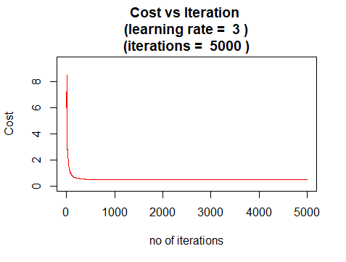
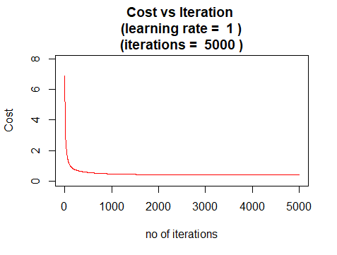
Deciding learning rate and number of iterations

Slide 12


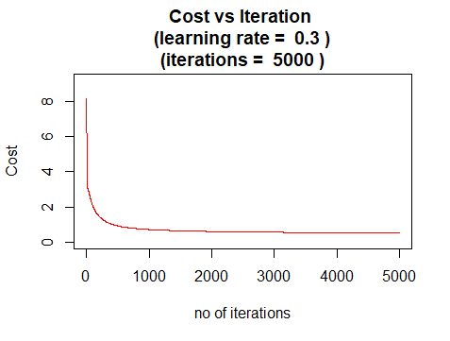

Deciding learning rate and number of iterations

Slide 13


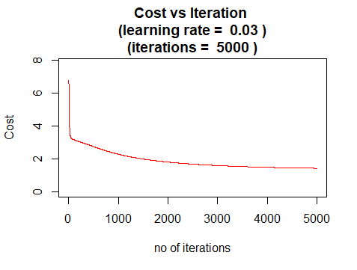

Deciding learning rate and number of iterations

Slide 14
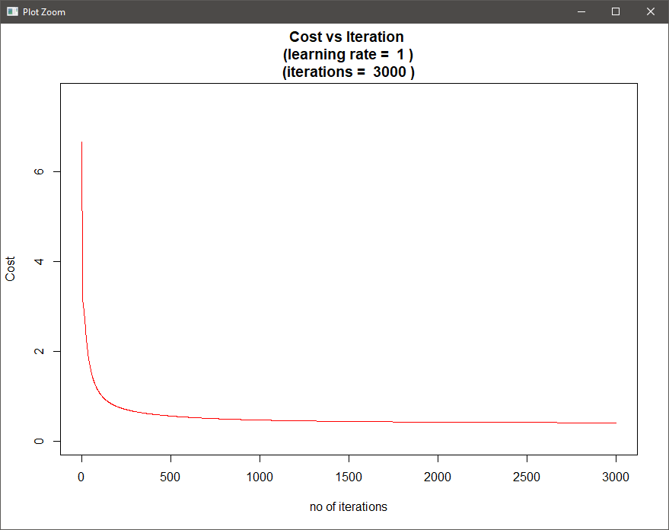
Our Model
By observations, we chose learning rate = 1 and number of iterations = 3000

Slide 15
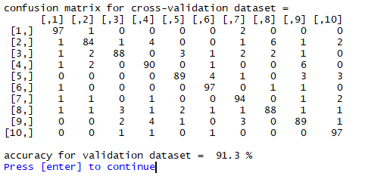
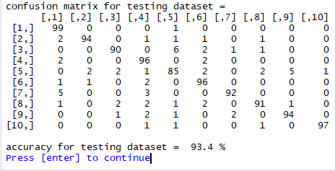
Confusion Matrix and accuracy of model on cross-validation and testing dataset

Slide 16

Prediction of digit from image
Resize image into 20x20 pixel
Convert image into matrix
Then normalize it and convert into vector of 400 length
Then feed this vector to model and forward propagate
After forward we will get vector of 10 length
Which position will have max value that will be our digit. If position = 10 then digit will be 0.

Slide 17
why Neural network?
Relatively easy to use compared to other algorithm in Artificial Intelligence algorithms except linear regression and logistic regression.
Great for complex/abstract problems like image recognition.
99.1% accuracy achieved for recognition of handwritten digits.

Slide 18
Applications of digit recognition
Natural language processing
Database creation
Packaging in food industry
Traffic security
Optical digit recognition

Slide 19
References
https://www.coursera.org/learn/machine-learning/
http://yann.lecun.com/exdb/mnist/
http://www.rroij.com/open-access/handwritten-digit-recognition-using-convolutional-neural-networks-10-15680IJIRCCE-2016-%200402001.pdf
https://www.coursera.org/learn/neural-networks-deep-learning

